Slide 1
Multi-Factor Key Derivation Function (MFKDF)
‹#›

Slide 2
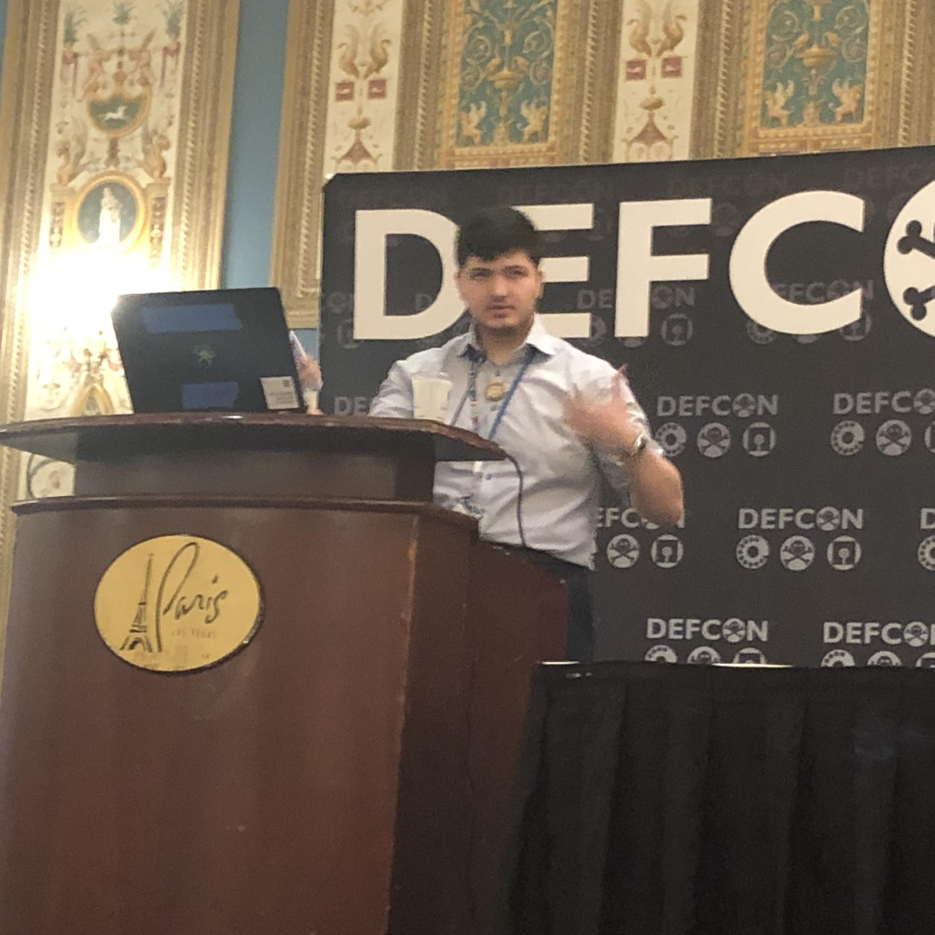
Vivek Nair
Ph.D. Student at UC Berkeley
https://nair.me · vivek@nair.me
MFKDF
‹#›

Slide 3
Acknowledgments
MFKDF
‹#›

Slide 4
Password Management Service
❶ Auth Request (Password)
❷ Auth Token
AUTH SERVER
❸ Auth Token
CLIENT
❹ Stored Data
DATABASE
MFKDF
‹#›

Slide 5
Password Management Service
Two problems with this architecture:
Passwords are insecure
❶ Auth Request (Password)
❷ Auth Token
AUTH SERVER
❸ Auth Token
CLIENT
❹ Stored Data
DATABASE
MFKDF
‹#›

Slide 6
Password Management Service
Two problems with this architecture:
Passwords are insecure
Databases are leaky
❶ Auth Request (Password)
❷ Auth Token
AUTH SERVER
❸ Auth Token
CLIENT
❹ Stored Data
DATABASE
MFKDF
‹#›

Slide 7
Password Management Service
Two problems with this architecture:
Passwords are insecure
Add MFA!
Databases are leaky
❶ Auth Request (Password + 2FA)
❷ Auth Token
AUTH SERVER
❸ Auth Token
CLIENT
❹ Stored Data
DATABASE
MFKDF
‹#›

Slide 8
Password Management Service
Two problems with this architecture:
Passwords are insecure
Add MFA!
Databases are leaky
Add PBKDF!
❶ Auth Request (Password + 2FA)
❷ Auth Token
AUTH SERVER
PBKDF
❸ Auth Token
CLIENT
❹ Encrypted Data
DATABASE
MFKDF
‹#›

Slide 9
Password Management Service
Two problems with this architecture:
Passwords are insecure
Add MFA!
Databases are leaky
Add PBKDF!
❶ Auth Request (Password + 2FA)
❷ Auth Token
AUTH SERVER
PBKDF
❸ Auth Token
CLIENT
❹ Encrypted Data
DATABASE
MFKDF
‹#›

Slide 10
Password Management Service
Two problems with this architecture:
Passwords are insecure
Add MFA!
Databases are leaky
Add PBKDF!
Can we incorporate MFA into the key derivation function itself?
❶ Auth Request (Password + 2FA)
❷ Auth Token
AUTH SERVER
PBKDF
❸ Auth Token
CLIENT
❹ Encrypted Data
DATABASE
MFKDF
‹#›

Slide 11
MULTI-FACTOR KEY DERIVATION
MULTI-FACTOR DERIVED KEY
The MFKDF outputs a key as a function of all input factors
FACTOR 01
FACTOR 02
FACTOR 03
FACTOR 04
eg. a Password
eg. a TOTP Code
eg. a U2F Token
eg. Biometric Data
MFKDF
‹#›

Slide 12
FACTOR 01
One-Way Function (OWF)
STATIC KEY
eg. a Password
hunter2
FACTOR 02
???
STATIC KEY
eg. a TOTP Code
196353 778449 843812 234823 …
MFKDF
‹#›

Slide 13
α_{K,0}
W_{FA,0}
W_{FB,0}
…
α_{FA,0}
α_{FB,0}
…
FactorDerive
FactorDerive
…
σ_{FA}
σ_{FB}
…
1st derivation
MFKDFDerive
K
FactorUpdate
FactorUpdate
…
α_{FA,1}
α_{FB,1}
…
MFKDF
α_{K,1}
‹#›

Slide 14
HOTP
α_{K,0}
W_{FA,0}
555555
K: Derived Key
H: HOTP Key
ct: Enc(H, K)
α_{FA,0}
Δ=-222222
FactorDerive
σ_{FA}
333333
MFKDFDerive
K
H: Dec(ct, K)
Next: 888888
FactorUpdate
α_{FA,1}
Δ=-555555
MFKDF
α_{K,1}
‹#›

Slide 15
Other Factors:
MFKDF
‹#›

Slide 16
Entropy & Brute Force
Intentionally inefficient!
PBKDF
DK = PBKDF2(PRF, Password, Salt, Rounds, dkLen)
MFKDF
DK = MFAKDF(PRF, [f1,f2,...fn], Rounds, dkLen)
= PBKDF2(PRF, f1⋅f2⋅f3, Salt, Rounds, dkLen)
Difficulty is on top of all authentication factors!
MFKDF
‹#›

Slide 17
users
users
user | hash
user1 | PBKDF(password)
user2 | PBKDF(password)
user | hash
user1 | MFKDF(password, HOTP, …)
user2 | MFKDF(password, HOTP, …)
MFKDF

Slide 18
Key ≈40b
Password ≈40b
MFKDF

Slide 19
Key ≈40b
Key ≈162b
≈1 hour
≈10¹⁰⁰ years
2/3
Password ≈40b
Password ≈40b
YubiKey 160b
Code 122b
MFKDF

Slide 20
Password Management Service
Two problems with this architecture:
Passwords are insecure
Add MFA!
Databases are leaky
Add PBKDF!
Can we incorporate MFA into the key derivation function itself?
❶ Auth Request (Password + 2FA)
❷ Auth Token
AUTH SERVER
PBKDF
✓
❸ Auth Token
CLIENT
❹ Encrypted Data
DATABASE
MFKDF
‹#›

Slide 21
Password Management Service
❶ Auth Request (Password + 2FA)
❷ Auth Token
AUTH SERVER
PBKDF
❸ Auth Token
CLIENT
❹ Encrypted Data
What happens if the password is lost?
DATABASE
MFKDF
‹#›

Slide 22
NIST SP 800-57: Key Recovery
Data Encryption Key (DEK): Used to encrypt user data
EncData = Enc(Data, DEK)
User Password
🔒 PBKDF2
User Data
Key Encryption Key (KEK): Password- derived key used to encrypt DEK
EncKey = Enc(DEK, KEK)
Key Encryption Key (KEK)
🔒 AES-256
🔒 AES-256
Data Encryption Key (DEK)
Master Key (MK): Centrally-stored key used to recover DEK
RecKey = Enc(DEK, MK)
Master Key (MK)
🔒 AES-256
Single point of failure
MFKDF
‹#›

Slide 23
THRESHOLD MULTI-FACTOR KEY DERIVATION
2-OF-3 DERIVED KEY
The MFKDF outputs a key as a function of any 2 input factors
FACTOR 01
FACTOR 02
FACTOR 03
eg. a Password
eg. a TOTP Code
eg. a Recovery Code
MFKDF
‹#›

Slide 24
Key Stacking
2-OF-3 DERIVED KEY
The MFKDF outputs a key as a function of any 2 input factors
FACTOR 01
FACTOR 02
FACTOR 03
eg. a Password
eg. a TOTP Code
eg. a Recovery Code
MFKDF
‹#›

Slide 25
Key
2/3
AND
Password
TOTP
OR
Email
Security Questions
Recovery Code
MFKDF

Slide 26
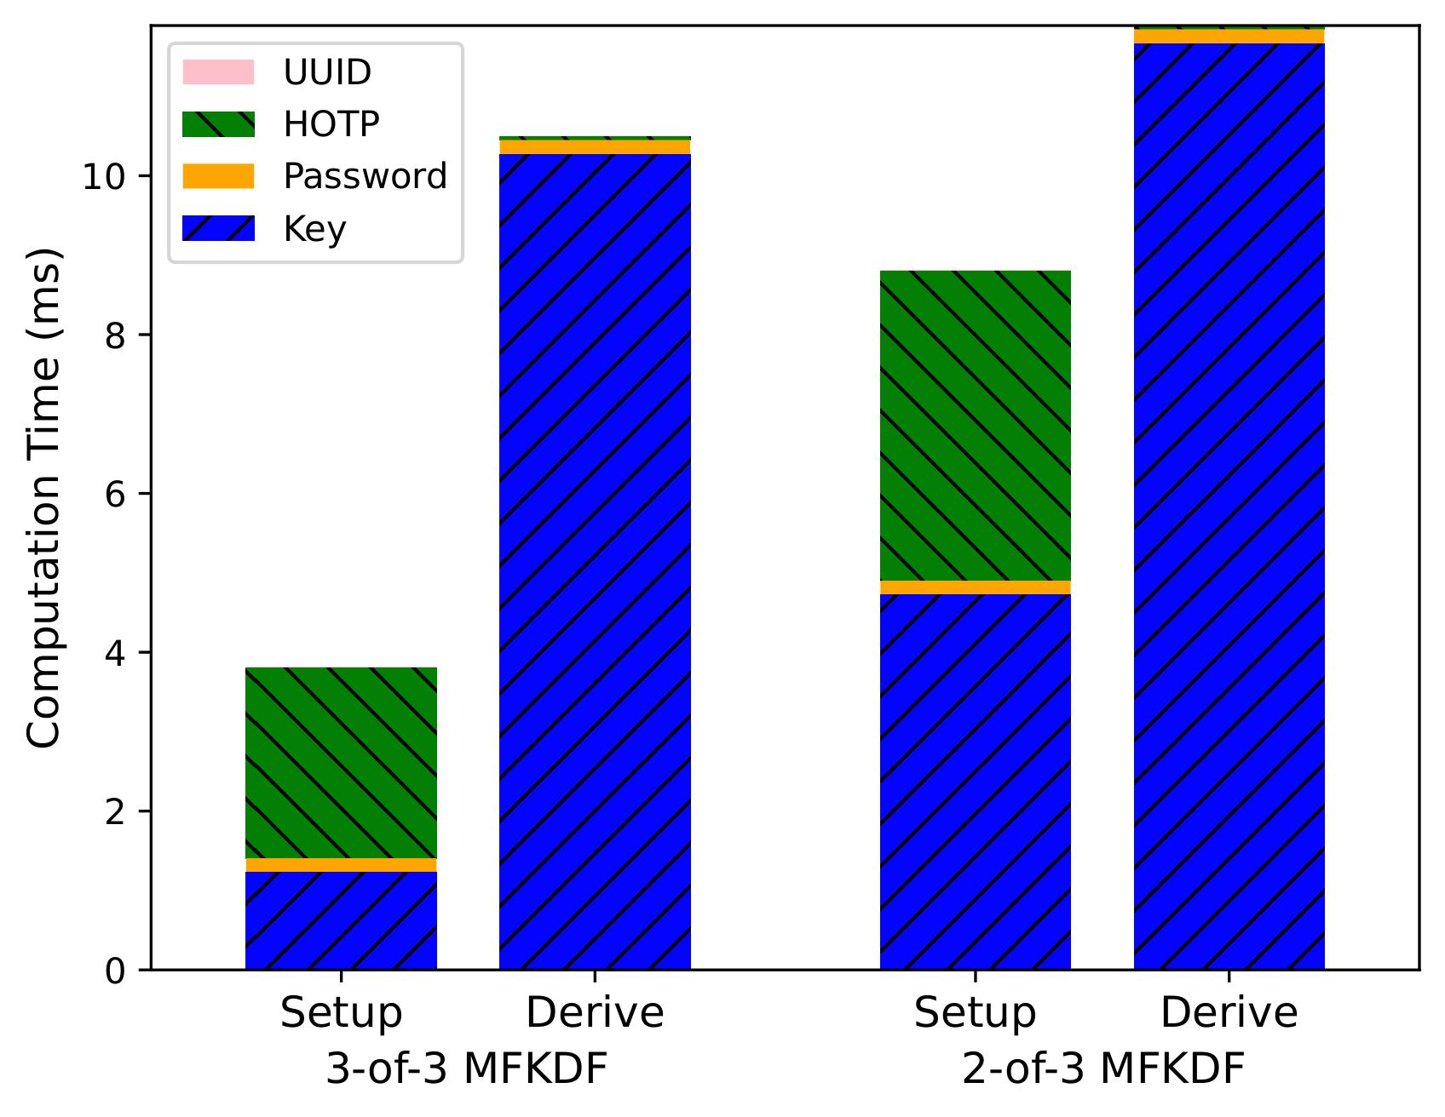
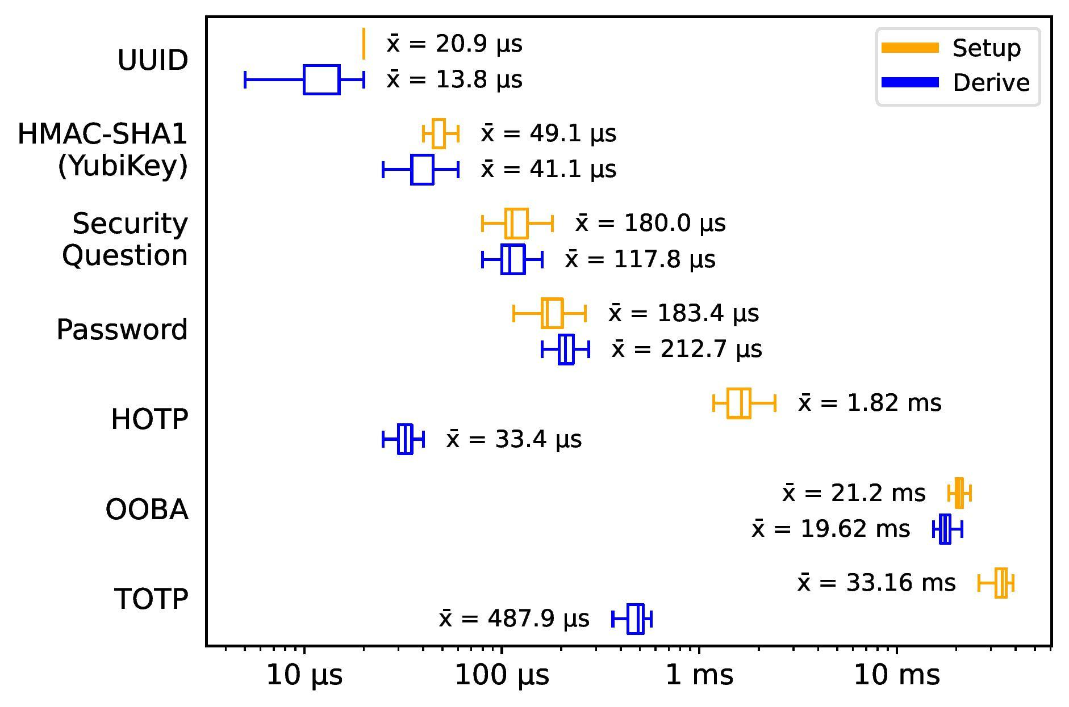
Performance
MFKDF
‹#›

Slide 27
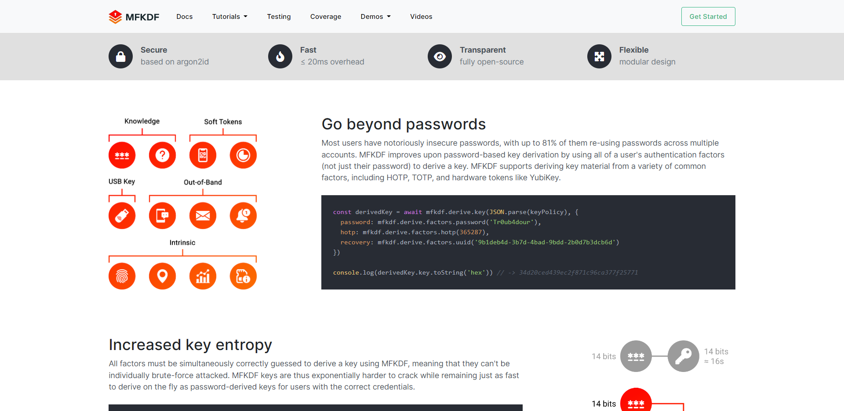
mfkdf.com
← pbkdf2.com
MFKDF
‹#›

Slide 28
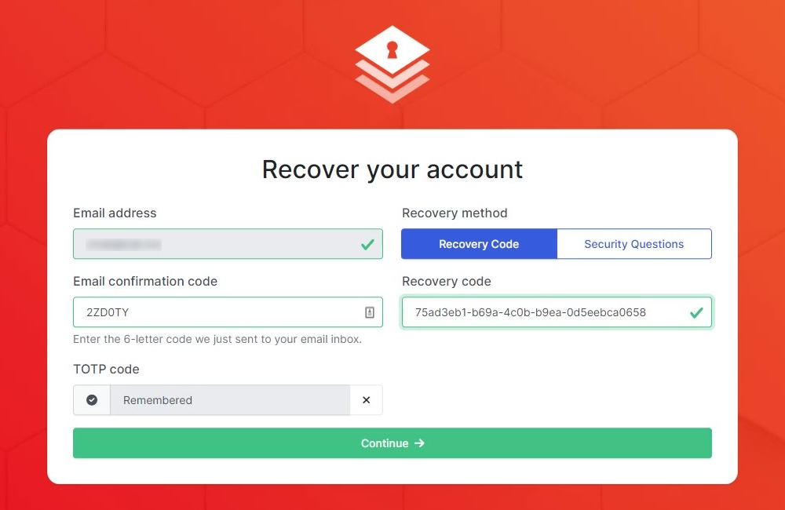
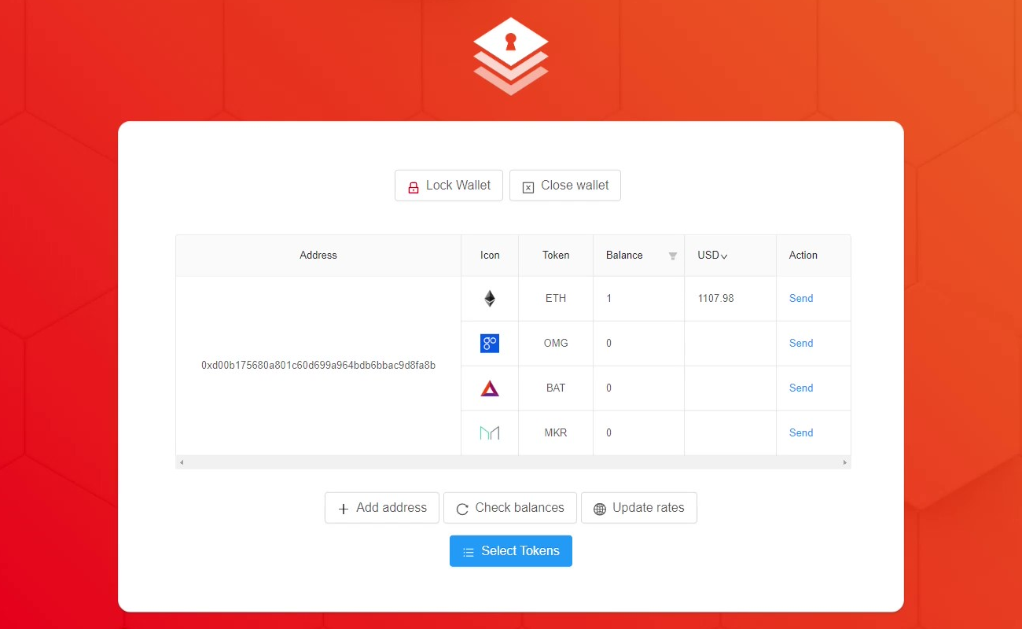
Centralized & Decentralized Demos
https://demo.mfkdf.com
https://wallet.mfkdf.com
MFKDF
‹#›

Slide 29
Key
MFKDF Policy
IPNS
eigb...oaw
IPFS
bafk...vx3u
Password
YubiKey
Code
MFKDF

Slide 30
Custodial Wallet
Non-custodial Wallet
MFKDF Wallet
✔ Portability
✘ Portability
✔ Portability
✔ Recoverability
✘ Recoverability
✔ Recoverability
✔ MFA
✘ MFA
✔ MFA
✔ Common Factors
✘ Common Factors
✔ Common Factors
✘ Decentralized
✔ Decentralized
✔ Decentralized
✘ Trustless
✔ Trustless
✔ Trustless
MFKDF

Slide 31
PBKDF2 is also used in…
MFKDF
‹#›

Slide 32
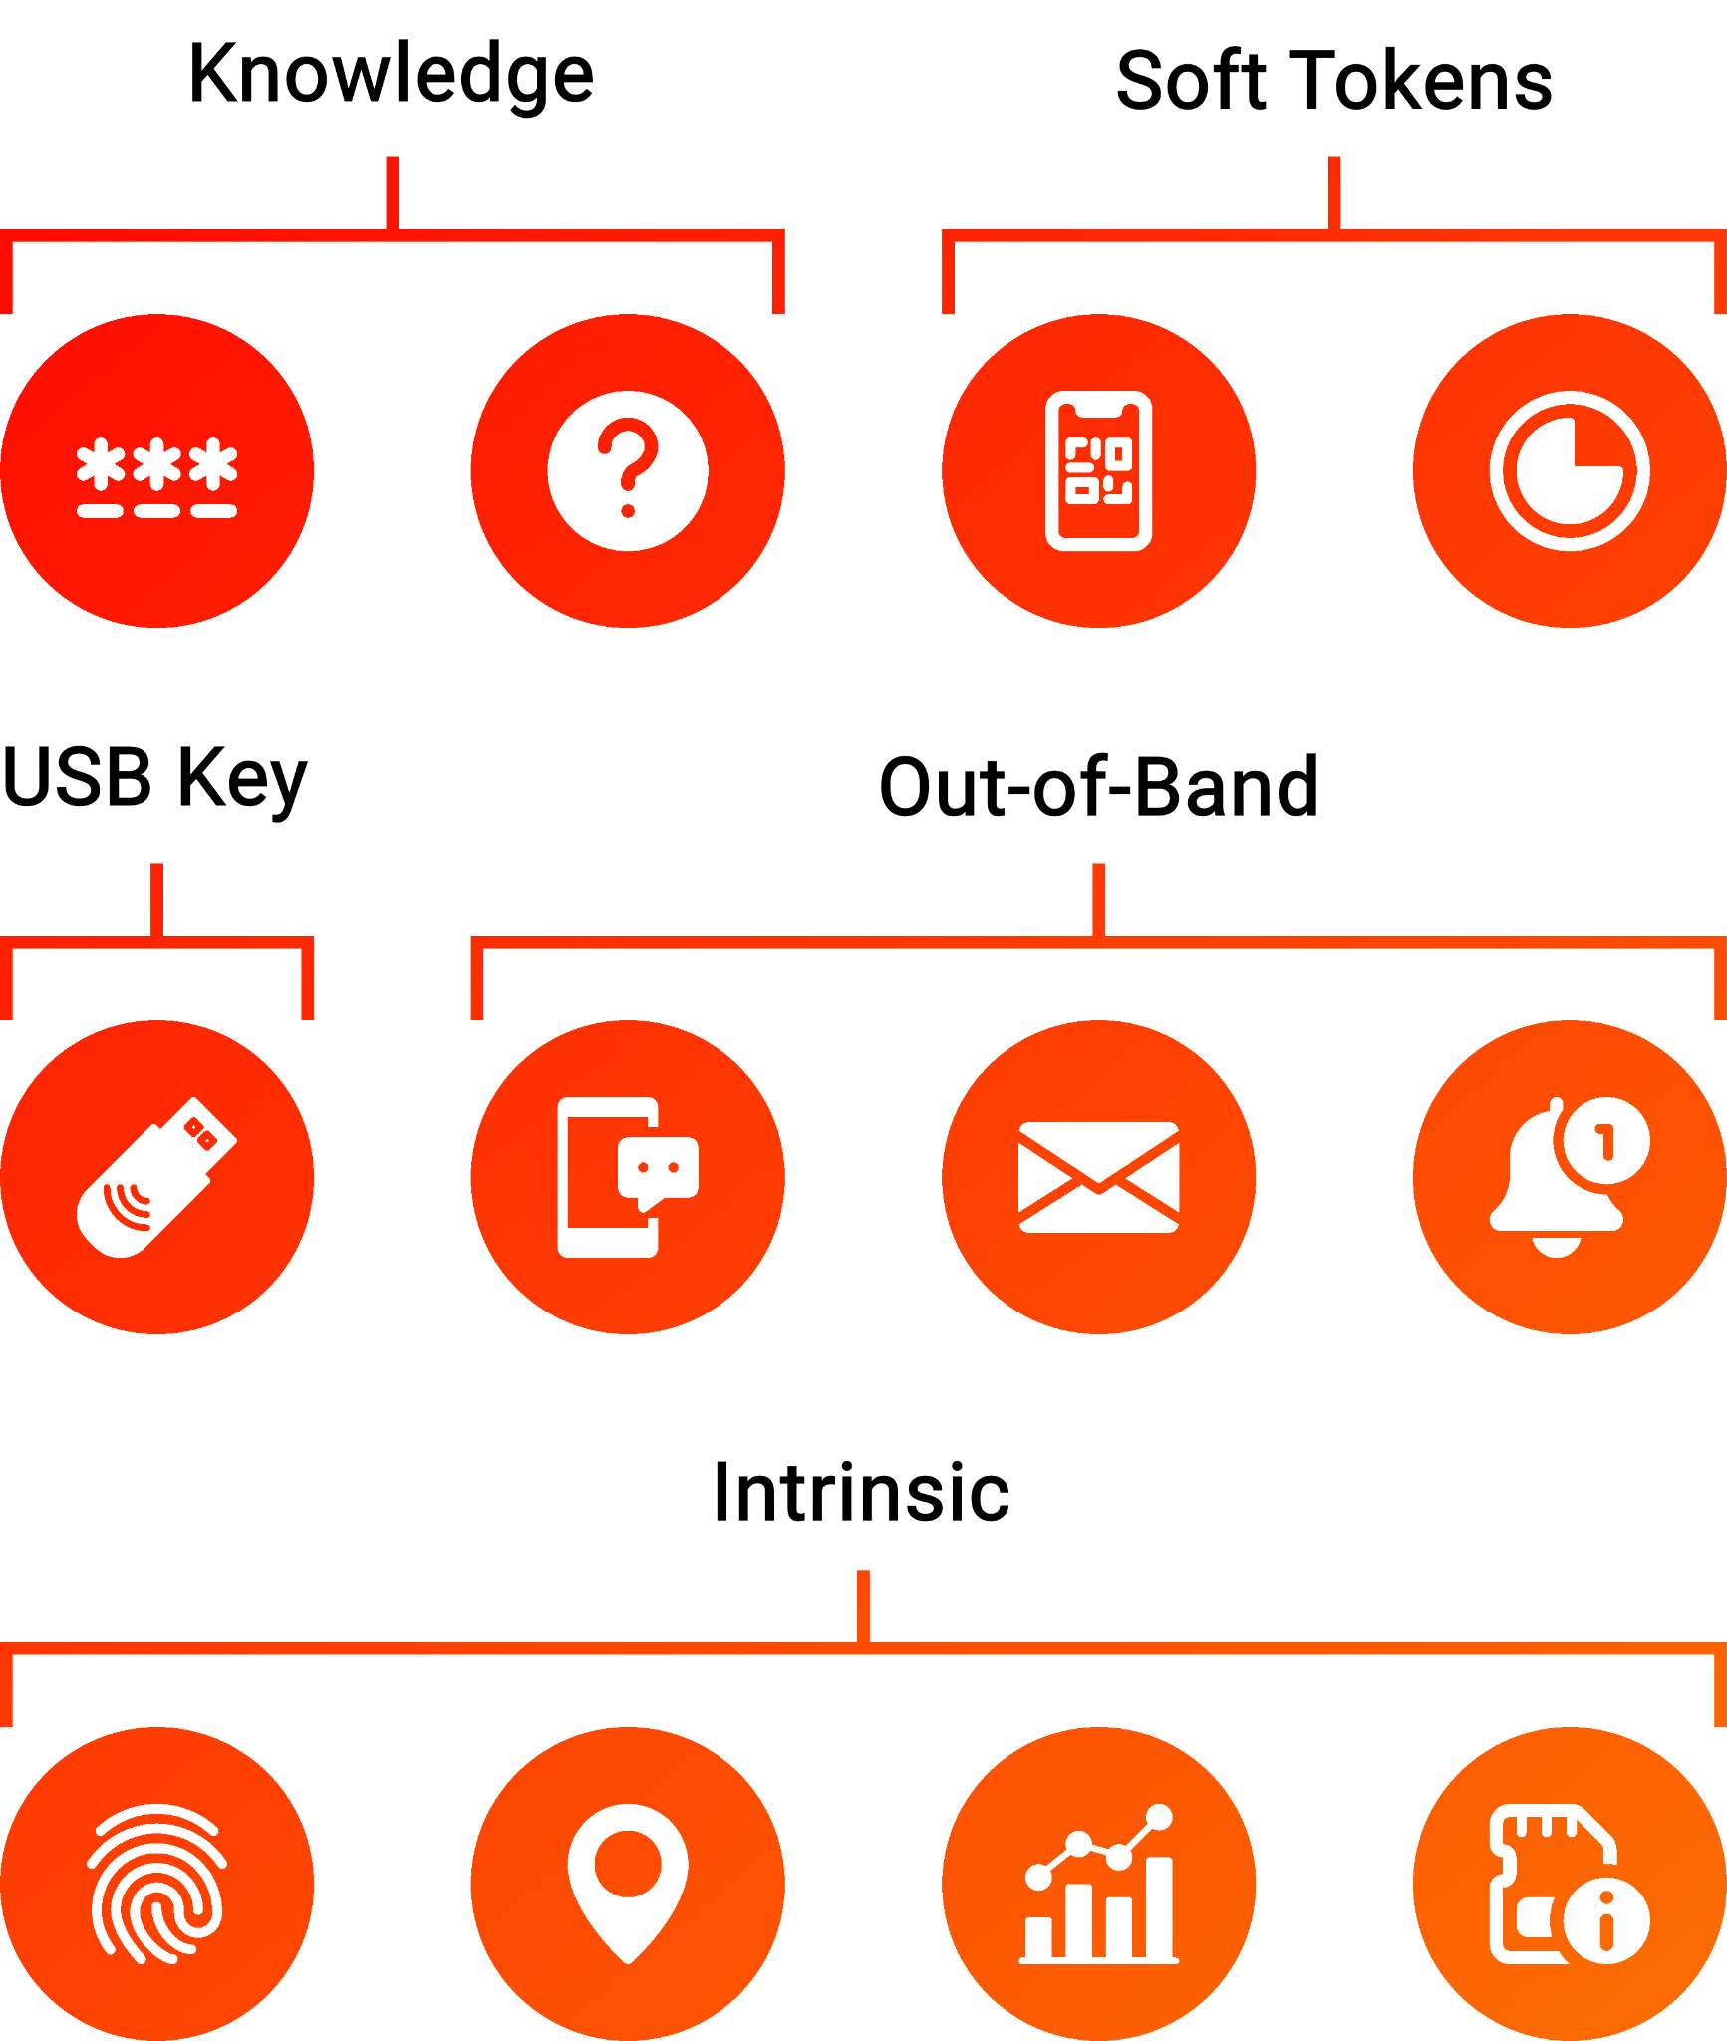
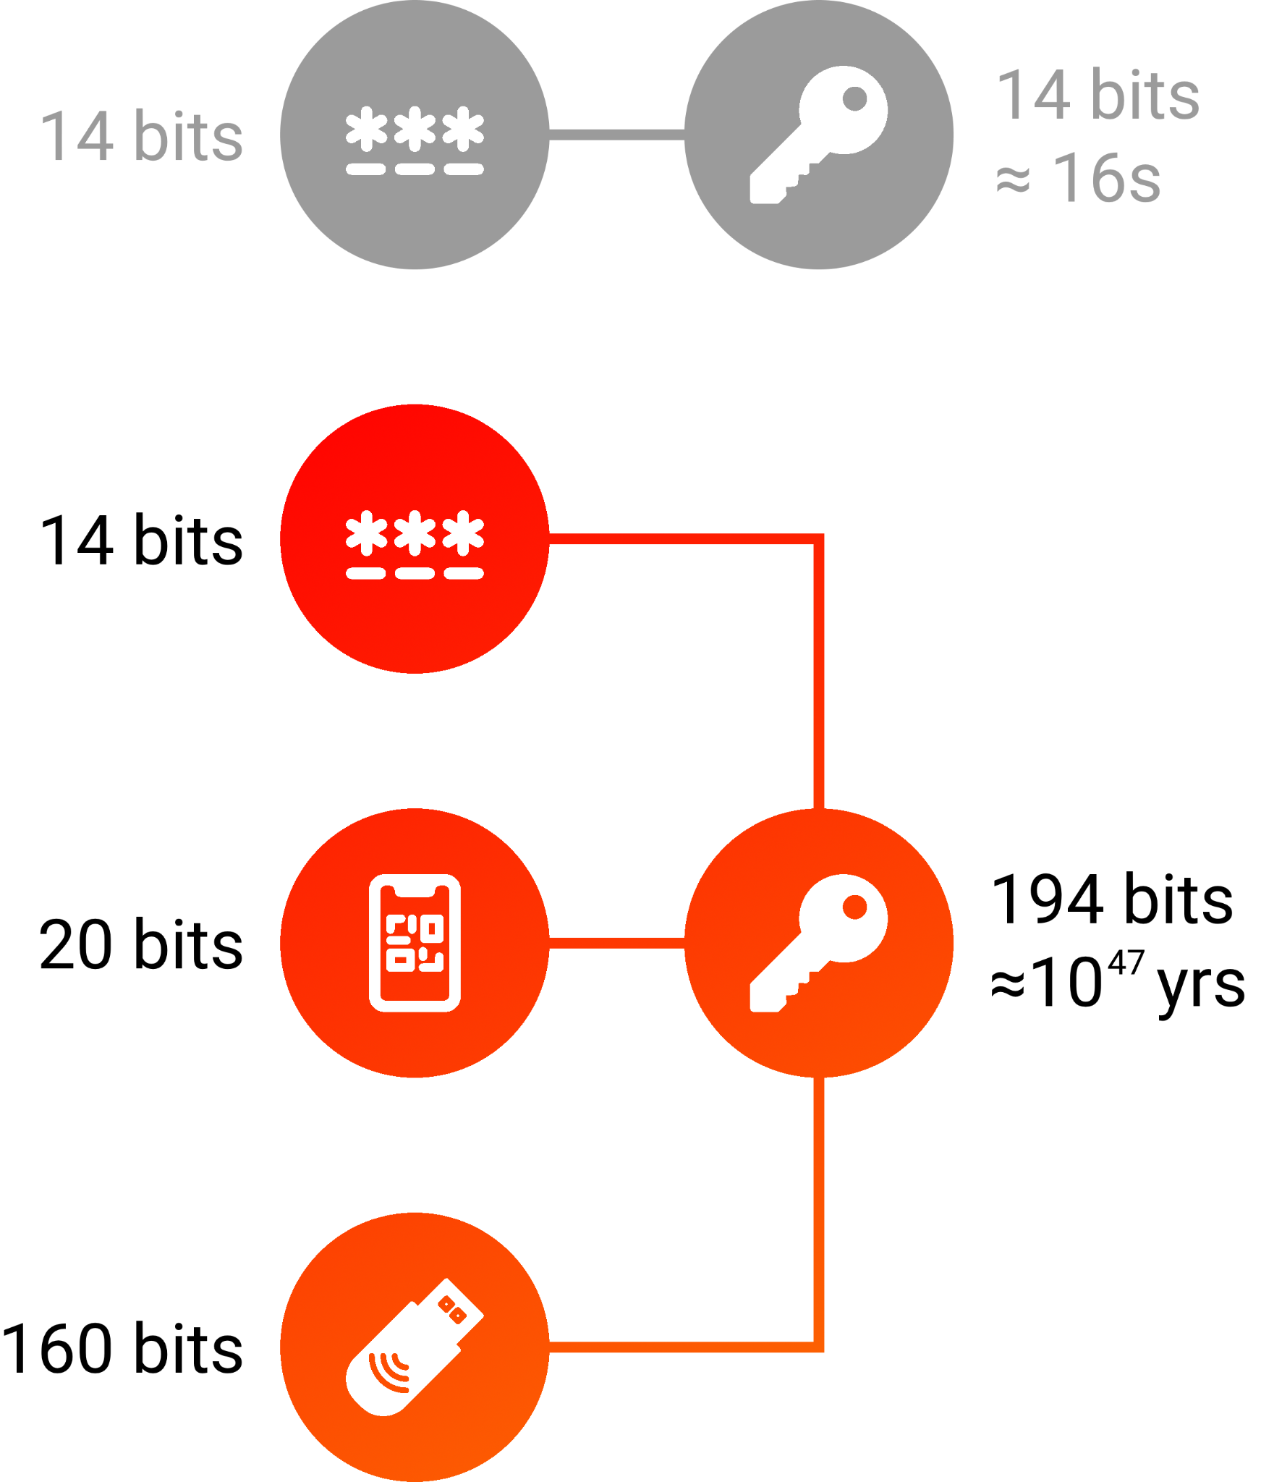
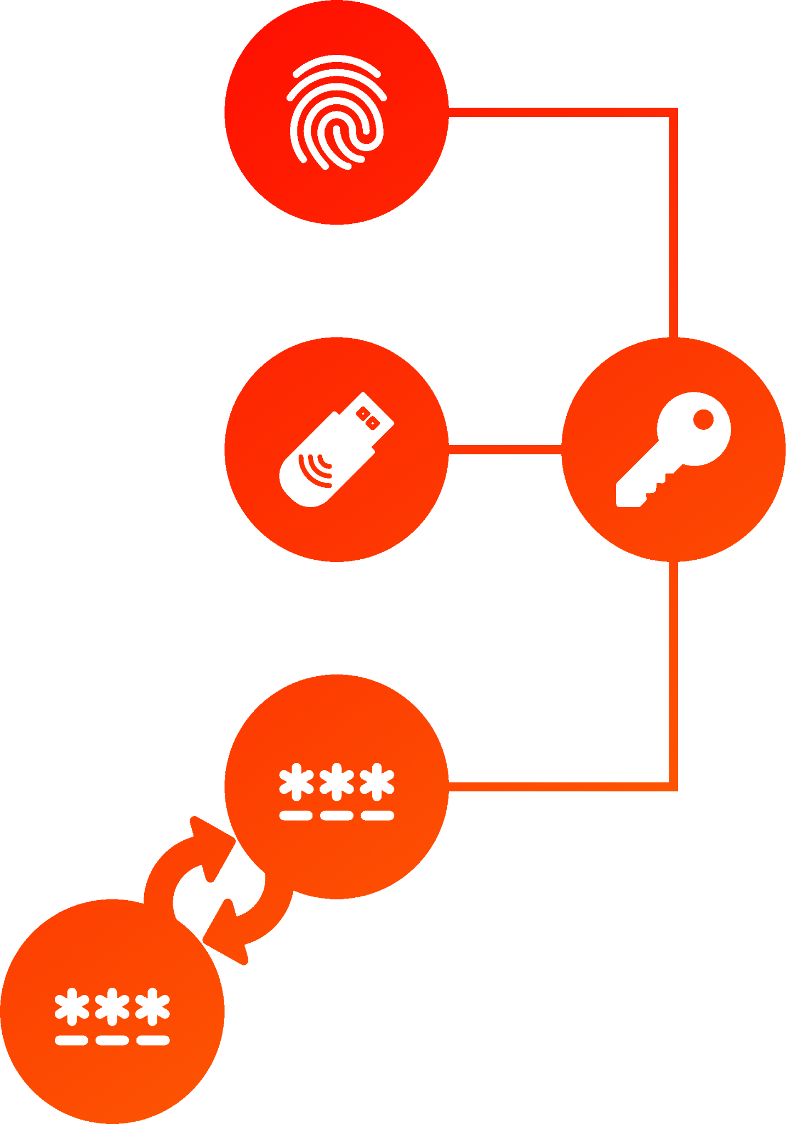
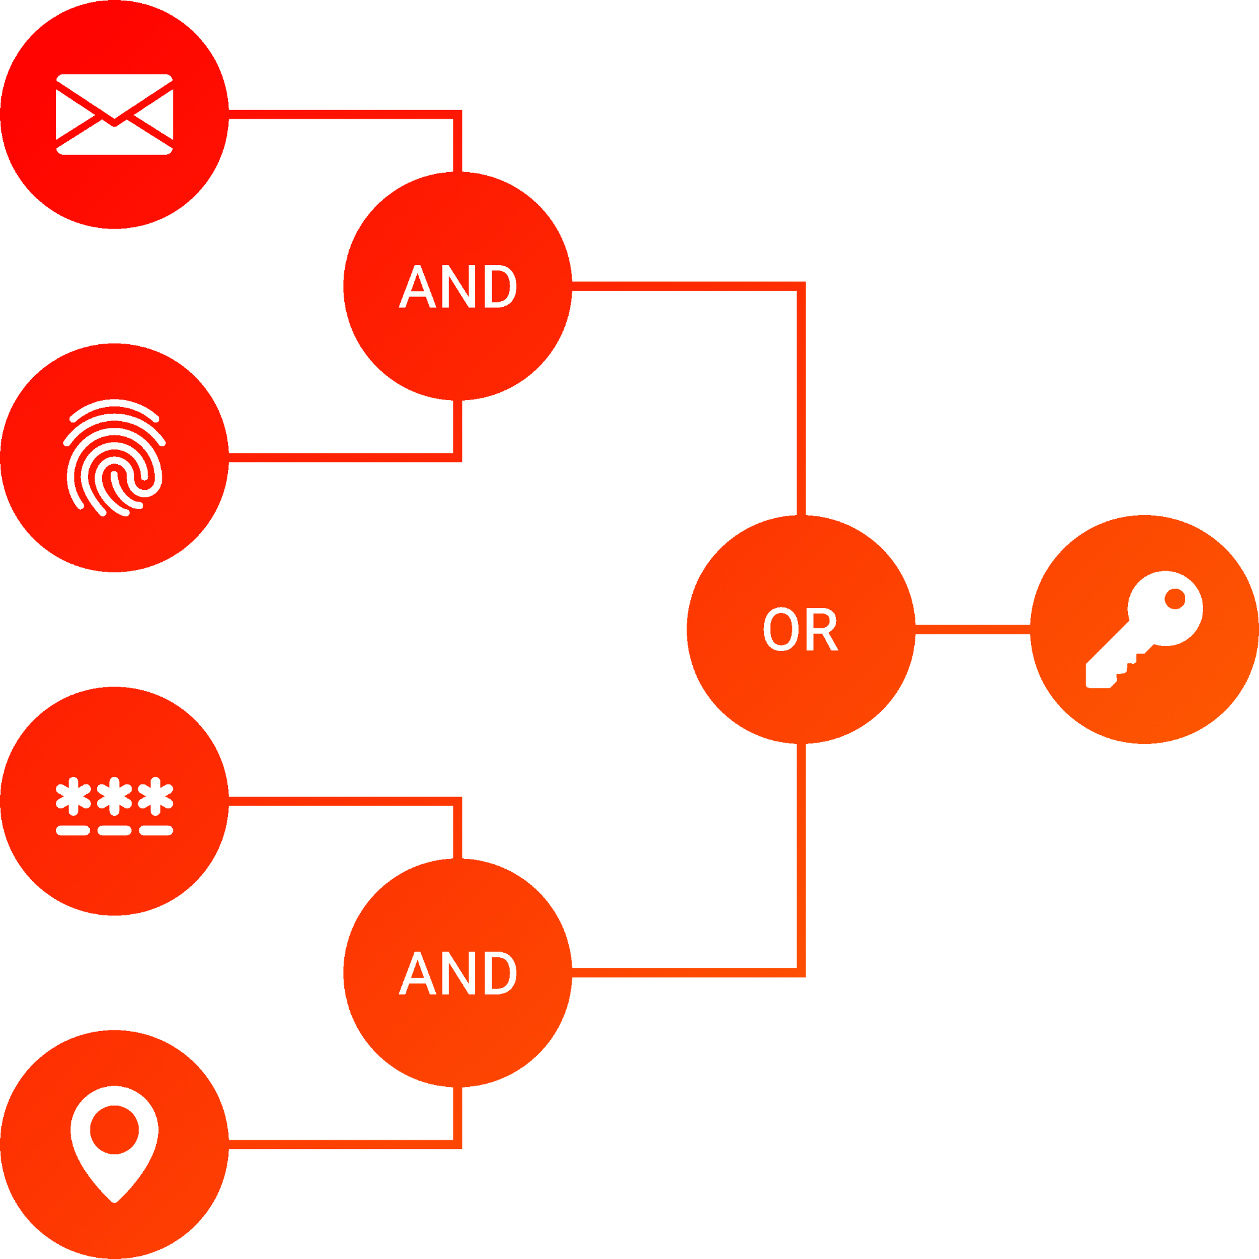
MFKDF Summary
MFKDF
USABILITY & FACTOR COMPATIBILITY
EXPONENTIAL SECURITY
CLIENT-SIDE RECOVERY
POLICY ENFORCEMENT
HIGHLY PERFORMANT
NEW & EXISTING APPLICATIONS
‹#›

Slide 33
Thanks!
https://mfkdf.com
https://arxiv.org/abs/2208.05586
https://github.com/multifactor/mfkdf
‹#›

